Slide 1
Introduction to Java Programming
History, Syntax, and Core Concepts
Presented By: Mirazul Islam Adjunct Lecturer, NUB

Slide 2
Table of Content
Brief History of Java
Features of Java
Applications of Java
Key Differences Between Java and C++
Sample Java Program
Data Types in Java
Basic Concepts of OOP
Abstraction
Encapsulation
Inheritance
Polymorphism

Slide 3
Brief History of Java
Developed by Sun Microsystems in the mid-1990s.
Originally called "Oak"; renamed Java in 1995.
Java 1.0 released in 1996.
It is now owned by oracle, and more than 3 billon devices run Java.

Slide 4
Features of Java
Java
Object Oriented
Secured
Platform Independent
Multi
threading

Slide 5
Applications of Java
Desktop GUI
Mobile App
Game Development
Web Based App
Enterprise
Scientific

Slide 6
Key Differences Between Java and C++
Java
Platform independent
C++
Platform dependent
Automatic garbage collector
Memory management is handled manually
Slow
Fast
Limited support for pointers
Strongly support pointer

Slide 7
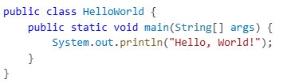
Sample Java Program
Java Source Code (.java file)
Java Compiler
Bytecode File (.class file)
JVM
Machine Code

Slide 8
Data Types in Java
Data Type
Primitive
Non-Primitive
string
Boolean
Numeric
array
etc.
Character
Integral
Integer
Float
byte
boolean
char
short
float
int
double
long

Slide 9
Basic Concepts of OOP
Object
Class
Encapsulation
Inheritance
Abstrac
tion
Polymor
phism

Slide 10
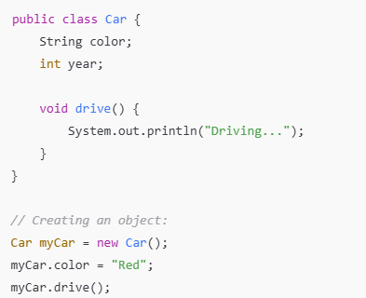
Objects and Classes
Classes:
Blueprint for objects.
Define attributes (fields) and behaviors (methods).
Objects:
Instances of classes.
Created using the new keyword.

Slide 11
Abstraction
Hides implementation details and only exposes the essential functionalities.
Ways to Achieve Abstraction in Java.
Abstract classes
A class with abstract methods.
Interfaces
Allow multiple inheritance.
Can’t be instantiated.

Slide 12
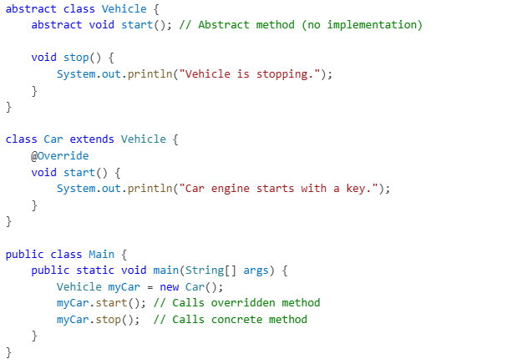
Abstract Classes
Useful when classes share common behavior but also require some unique implementation.

Slide 13
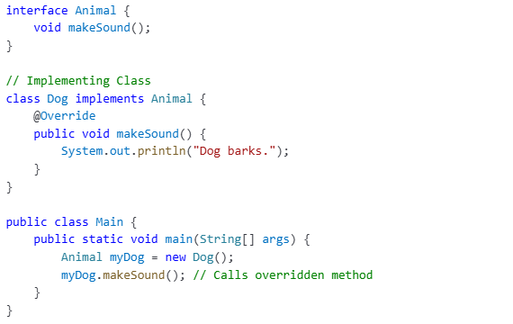
Interfaces
A class can implement multiple interfaces, unlike inheritance.

Slide 14
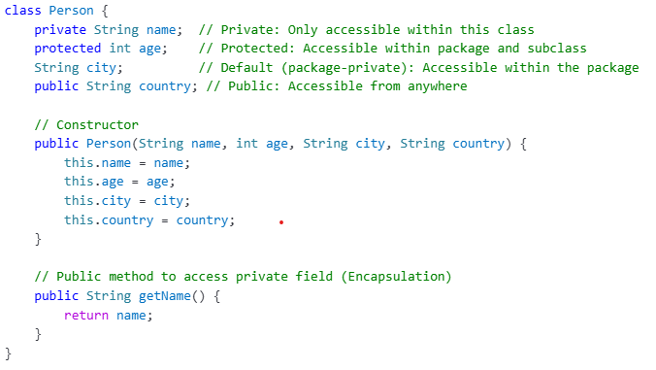
Encapsulation
Wrapping of data and functions into a single unit

Slide 15
Inheritance
A child class (subclass) inherits properties and behaviors (methods) from a parent class (superclass).
Types of Inheritance in Java
Single Inheritance
Multilevel Inheritance
Hierarchical Inheritance
Multiple Inheritance(via interface)

Slide 16
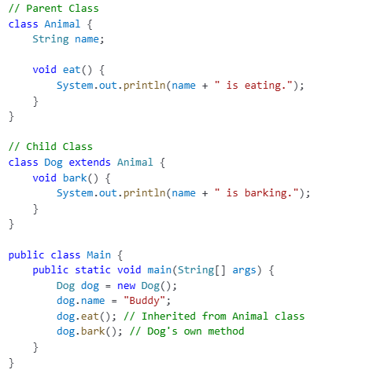
Single Inheritance
Base Class
Clild Class

Slide 17
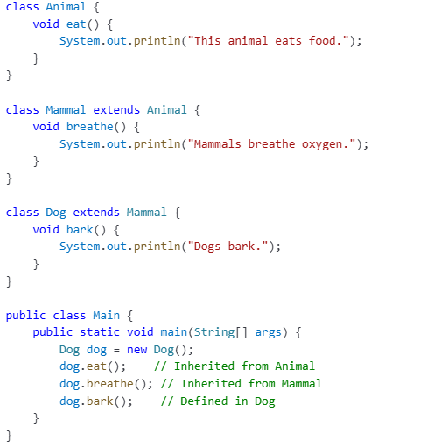
Multilevel Inheritance
Base Class
Intermediate Class
Derived Class

Slide 18
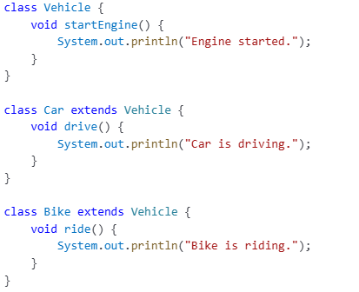
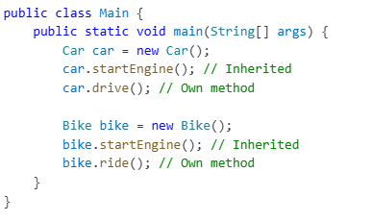
Hierarchical Inheritance
Base Class
Derived Class
Derived Class

Slide 19
Polymorphism
allows a single interface to represent multiple behaviors.
Types of Polymorphism in Java.
Compile-time Polymorphism(Method Overloading)
multiple methods with the same name but different parameters.
Run-time Polymorphism(Method Overriding)
The method call is resolved at compile time(static binding).
Same method name, same parameters but defer in subclass.
The method call is determined at runtime(dynamic binding).

Slide 20
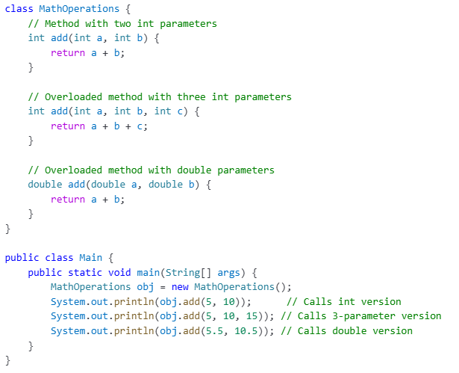
Method Overloading

Slide 21
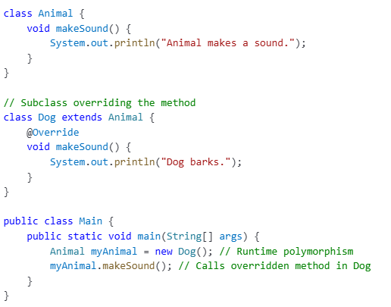
Method Overriding

